Slide 1
LIGHTNING TALK
WHY HASKELL?!
ANNIE NGUYEN
December 11, 2017

Slide 2


1990
Formed by a committee
Research language
Purely functional programming language
Lazy Evaluation
Haskell Curry/logician
Simon Peyton Jones – Main Contributor

Slide 3
Simon Peyton Jones -Haskell is Useless
Useful
C, C++,
C# Java
"Nirvana"
Useless
Haskell
Unsafe
Safe

Slide 4
Functions and Currying
f :: Int -> Int
f x = x * 2 + 1
f 5 == 11
g :: Int -> Int -> Int
g x y = x * 2 + y
g 1 2 == (g 1) 2 == 4
Partially applying g to 1

Slide 5
List comprehensions
[1, 2, 3]
[x * 3 + 1| x <- [1..5]]
== [4, 7, 10, 13, 16]
[(x, y)| x <- [1, 3], y <- ['a', 'b']]
== [(1,'a'),(1,'b'),(3,'a'),(3,'b')]

Slide 6
Pure function
Impure function
length :: [a] -> Int
putStrLn :: String -> IO ()
getLine :: IO String
No side effect
Same input same output
Like a mathematical function
Can have a side effect
Not always the same value
Interaction with the outside world

Slide 7
Immutable Lists
Haskell
Mutable Arrays
Java
update :: Int -> a -> [a] -> [a]
update ix e l = (take ix l) ++
[e] ++
(drop (ix + 1) l)
l = [1, 2, 3, 4, 5]
m = update 2 100 l -- m is a copy
int[] a = new int[]{1, 2, 3, 4, 5};
a[2] = 100; // a is modified

Slide 8
Declarative
Haskell
countEven :: [Int] -> Int
countEven [] = 0
countEven (x:xs) = (if even x then 1 else 0) +
countEven xs
Imperative
Java
static int countEven(int[] a) { int c = 0; for (int i = 0; i < a.length; i++) { if (a[i] % 2 == 0) { c += 1; } } return c; }

Slide 9
Recursive datatype
type
parameter
type
name
empty list
constructor
element append
constructor
data List a = Cons a (List a) | Nil
list
element
rest of
the list
Cons 1 (Cons 2 (Cons 3 Nil)) ~~ [1, 2, 3]

Slide 10
data List a = Cons a (List a) | Nil
passing a function
as an argument
map :: (a -> b) -> List a -> List b
map f Nil = Nil
map f (Cons a l) = Cons (f a) (map f l)
pattern matching
on the constructors
apply f to
current element
toName :: Int -> String
map toName (Cons 1 (Cons 2 Nil)) ==
(Cons "one" (Cons "two" Nil))

Slide 11
Maybe
data Maybe a = Just a | Nothing
div :: Int -> Int -> Maybe Int
div x 0 = Nothing
div x y = Just (x / y)
Partial function
printy :: String -> Maybe String -> String
printy str Nothing = "> " ++ str
printy str (Just pref) = pref ++ str
printy Nothing "Annie" == "> Annie"
printy (Just "+ ") "Annie" == "+ Annie"
Optional parameter

Slide 12
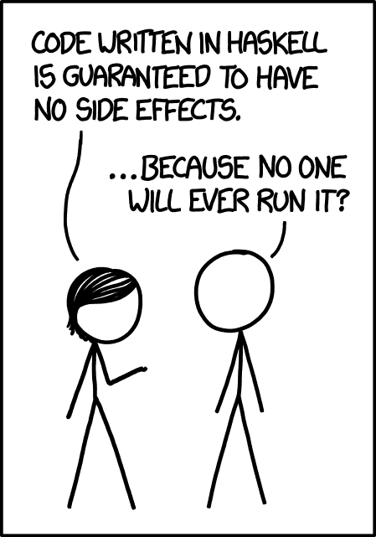
Research language
Isolate side effect
Recursive data types

